Slide 1
Selection Structures

Slide 2
Syntax of if Statement Two Alternatives
Form 1:
if ( condition )
statement _{T} ;
Eg:
if (x > 0.0)
pos_prod = pos_prod * x;
If condition evaluates to true (a nonzero value), then statement _{T} is executed; otherwise, statement _{T} is skipped.

Slide 3
Syntax of if Statement Two Alternatives
Form 2:
if ( condition )
statement _{T} ;
else
statement _{F} ;

Slide 4
Example
if (x >= 0.0)
printf("positive\n");
else
printf("negative\n");
If condition evaluates to true ( a nonzero value), then statement_{T} is executed and statement_{F} is skipped; otherwise, statement_{T} is skipped and statement_{F} is executed.

Slide 5
Example 1
#include<stdio.h>
void main()
{
int i=1;
if(i<1)
printf("Yes");
else
printf(“No”);
}

Slide 6
Output 1
No

Slide 7
Example 2
#include<stdio.h>
void main()
{
int i=2;
if(i)
printf("Yes");
else
printf(“No”);
}

Slide 8
Output 2
Yes

Slide 9
Example 3
#include<stdio.h>
void main()
{
char i =‘a’;
if(i)
printf("Yes");
else
printf(“No”);
}

Slide 10
Output 3
Yes

Slide 11
Example 4
#include<stdio.h>
void main()
{
int a = 2 , b=5;
if ((a==0)&&(b==1))
printf(“Hi”);
printf(“a is %d and b is %d”, a, b);
}

Slide 12
Output 4
a is 2 and b is 5

Slide 13
Example 5
#include<stdio.h>
void main()
{
int a = 2 , b=5;
if ((a==2)&&(b==1))
printf(“Hi”);
printf(“a is %d and b is %d”, a, b);
}

Slide 14
Output 5
a is 2 and b is 5

Slide 15
Conditional Operator (Ternary Operator)
Syntax:
expression 1 ? expression 2 : expression 3
“if expression 1 is true (that is, if its value is non-zero), then the value returned will be expression 2, otherwise the value returned will be expression 3”.

Slide 16
Conditional Operator (Ternary Operator)
Example:
char a ;
int y ;
scanf ( "%c", &a ) ;
y = ( a >= 65 && a <= 90 ? 1 : 0 ) ;
Here 1 would be assigned to y if a >=65 && a <=90 evaluates to true, otherwise 0 would be assigned

Slide 17
Conditional Operator (Ternary Operator)
Not necessary that conditional operators should be used only in arithmetic statements
Eg1:
int i ;
scanf ( "%d", &i ) ;
( i == 1 ? printf ( "Amit" ) : printf ( "All and sundry" ) )
Eg2:
char a = 'z' ;
printf ( "%c" , ( a >= 'a' ? a : '!' ) ) ;
Notes:
ASCII value of a=097 and z=122

Slide 18
Nested
Conditional operators can be nested :
int big, a, b, c ;
big = ( a > b ? ( a > c ? 3: 4 ) : ( b > c ? 6: 8 ) ) ;

Slide 19
Nested if Statements
if ( condition₁ )
statement₁
else if ( condition₂ )
statement₂
. . .
else if ( condition_{n})
statement_{n}
else
statement_{e}

Slide 20
Example
/* increment num_pos, num_neg, or num_zero depending on x */
if (x > 0)
num_pos = num_pos + 1;
else if (x < 0)
num_neg = num_neg + 1;
else /* x equals 0 */
num_zero = num_zero + 1;

Slide 21
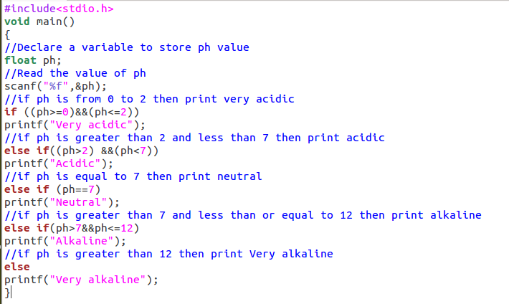

Slide 22
#define statements
These are preprocessor directives that are used define constants
When a value is defined using #define, if there is a change in value it is easier to make modification
Syntax:
#define PI 3.14
Notes:
#define PI 3.14

Slide 23
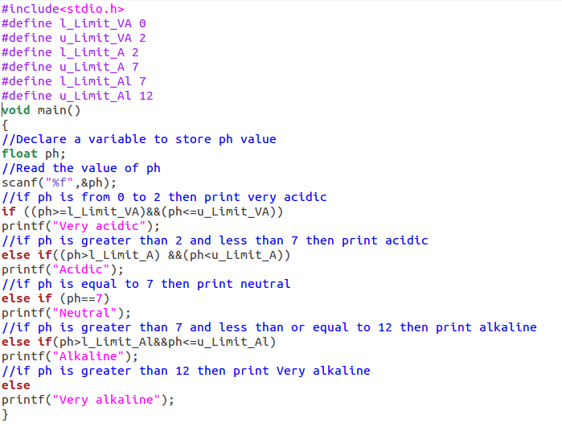

Slide 24
Switch Statement
Useful when the selection is based on the value of a single variable or of a simple expression (called the controlling expression)
Value of this expression may be of type int or char , but not of type double

Slide 25
Syntax of Switch Statement
switch ( controlling expression )
{
label set₁
statements₁
break;
label set_{n}
statements_{n}
break;
default:
statements_{d}
}

Slide 26
Syntax of Switch Statement
When a match between the value of the controlling expression and a case label value is found, the statements following the case label are executed until a break statement is encountered.
Then the rest of the switch statement is skipped.
If no case label value matches the controlling expression, the entire switch statement body is skipped unless it contains a default label.

Slide 27
#include <stdio.h>
int main()
{
int language = 10;
switch (language)
{
case 1:
printf("C#\n");
break;
case 2:
printf("C\n");
break;
case 3:
printf("C++\n");
break;
default:
printf("Other programming language\n");
}
}
Notes:
Output: Other programming language

Slide 28
Practice Problem
The table below shows the normal boiling points of several substances. Write a program that prompts the user for the observed boiling point of a substance in °C and identifies the substance if the observed boiling point is within 5% of the expected boiling point. If the data input is more than 5% higher or lower than any of the boiling points in the table, the program should output the message Substance unknown.

Slide 29
Substance | Normal boiling point (°C)
Water | 100
Mercury | 357
Copper | 1187
Silver | 2193
Gold | 2660

